Slide 2
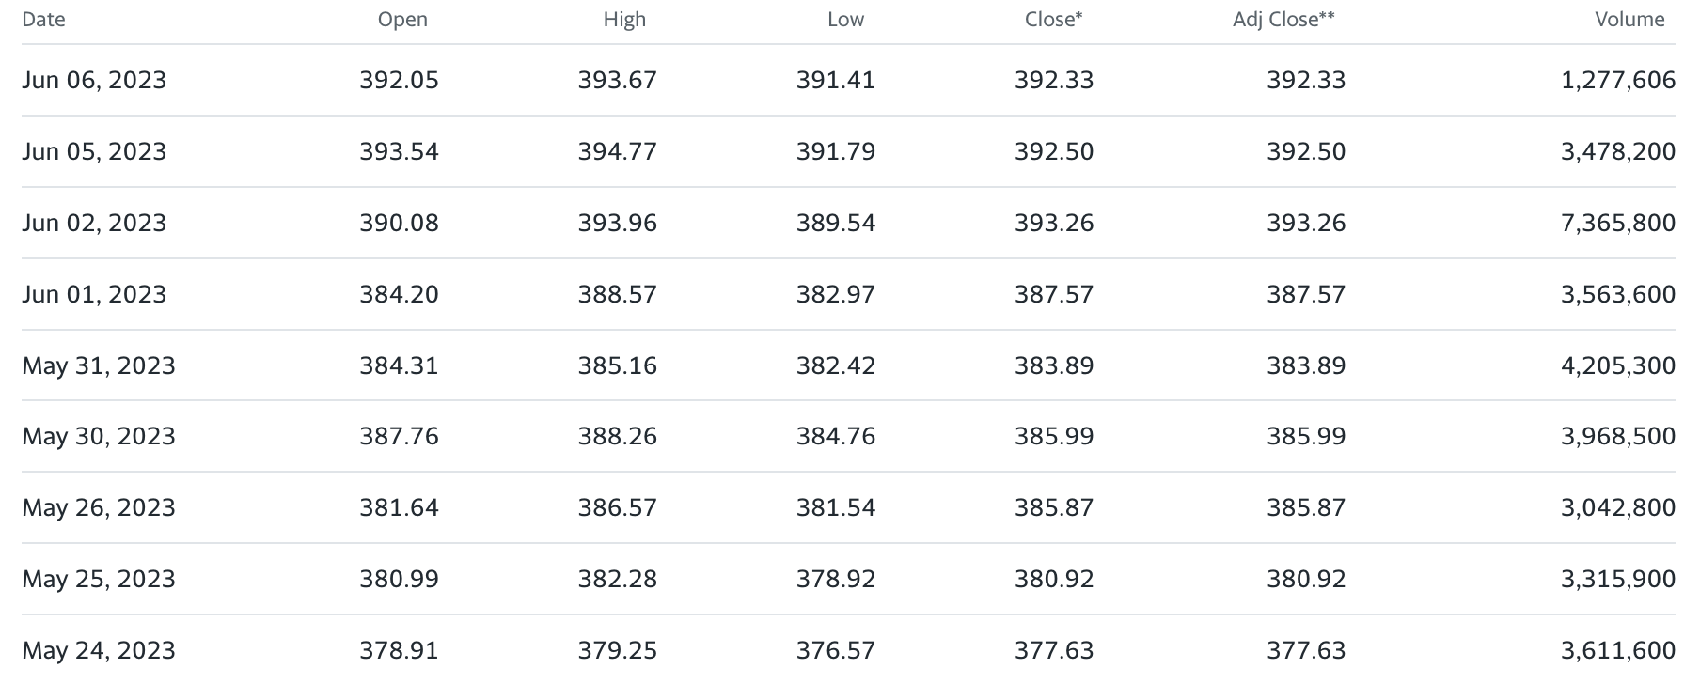
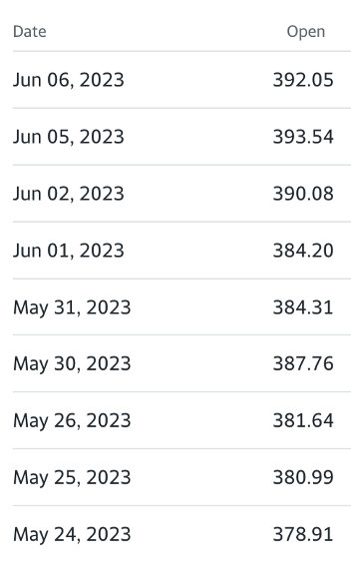
Method - preprocessing
Vanguard 500 Index Fund (VOO)
Multivariate Time Series of VOO
Univariate Time Series of VOO

Slide 3
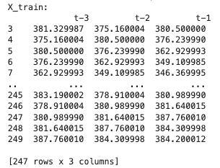
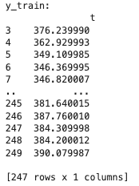
Method - preprocessing
y train
Univariate Time Series of VOO
X train
Supervised Machine Learning

Slide 4
Method - model
Supervised Machine Learning
Dense (100)
Dense (1)
MSE
Regression
Sequential
Univariate Uni-step MLP Model
Output

Slide 5
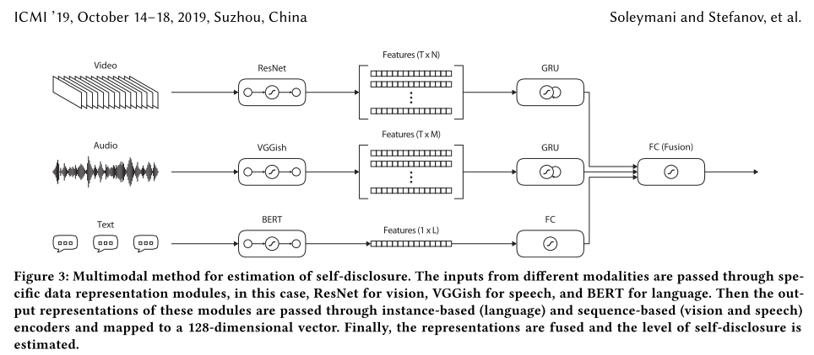
Example – https://dl.acm.org/doi/10.1145/3340555.3353737

Slide 6
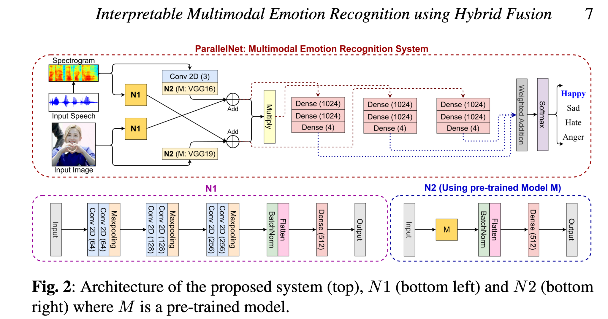
Example – https://arxiv.org/pdf/2208.11868.pdf

Slide 7
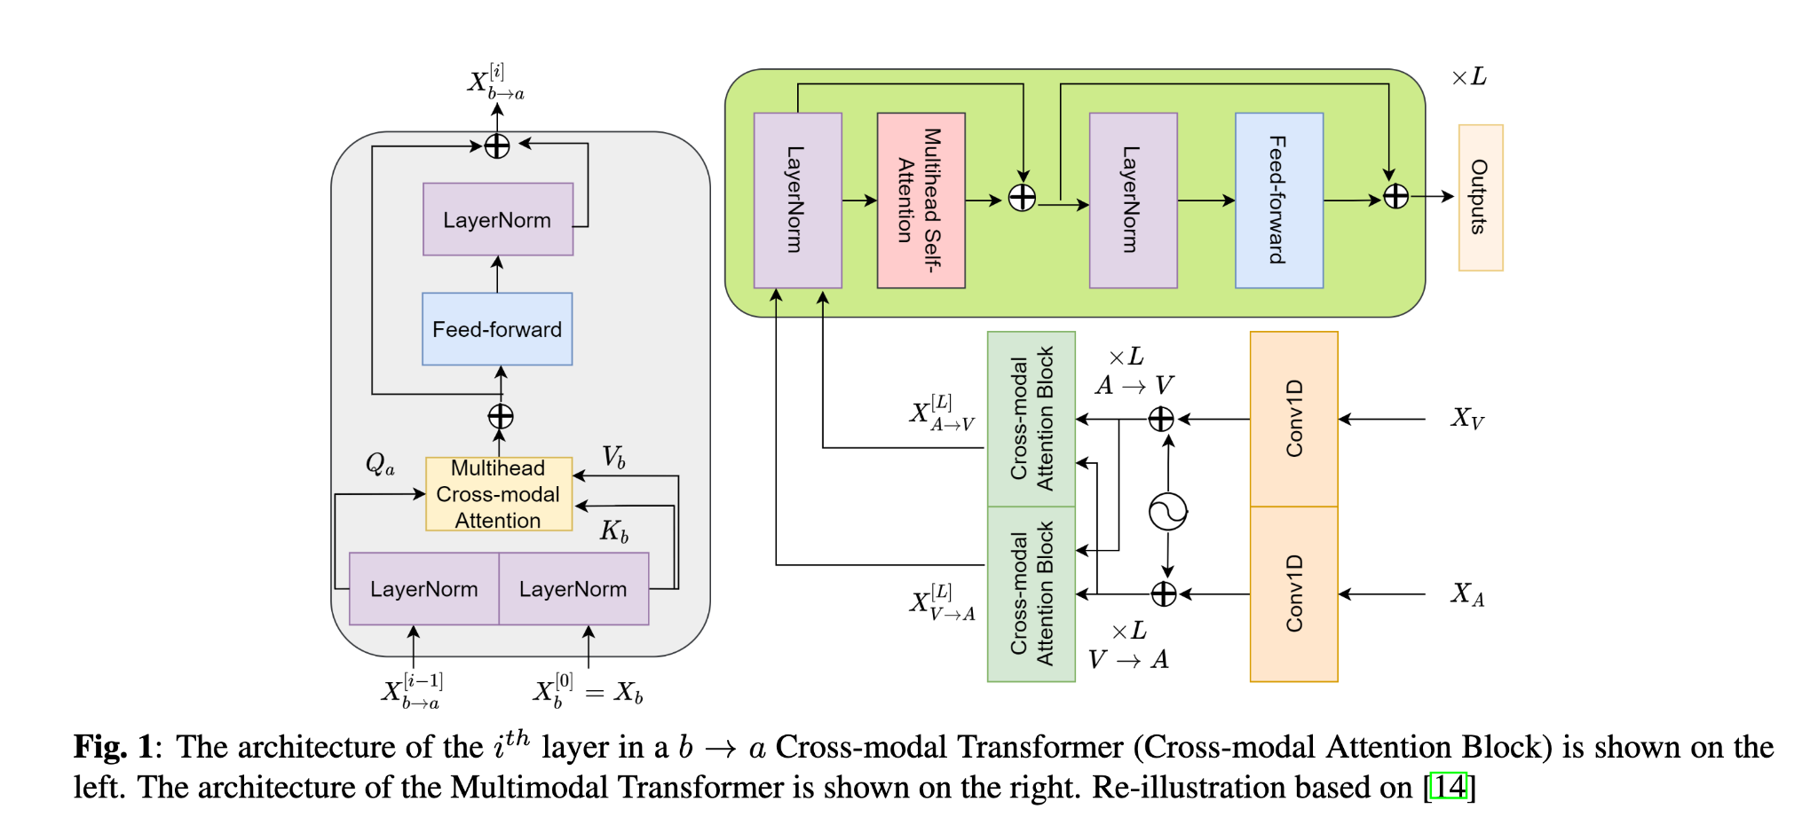
Notes:
chrome-extension://oemmndcbldboiebfnladdacbdfmadadm/https://arxiv.org/pdf/2201.09165.pdf
A PRE-TRAINED AUDIO-VISUAL TRANSFORMER FOR EMOTION RECOGNITION
Combine X_V and X_A

Slide 8
Interpretability
Hand-crafted (openSmile) vs end-to-end (openFace) using correlation or feature extraction
NID (feed forward)
SincNet (Convolutional filters)
Audio Inputs
Fusion
Outputs
Classification of emotion
Interpretability of what led to what classification
Visual Inputs
Data engineering - Extract feature sets (with openSMILE)
MFCC
PLP-CC
Prosody (Pitch + Loudness)
Etc
Notes:
Interpretability can be before or after classification

Slide 9
MIDTERM REPORT
INPUT:
MSP-IMPROV (audio)
OUTPUT:
Classification of emotion (Angry, Happy, Neutral, Sad)
Notes:
Interpretability can be before or after classification

Slide 10
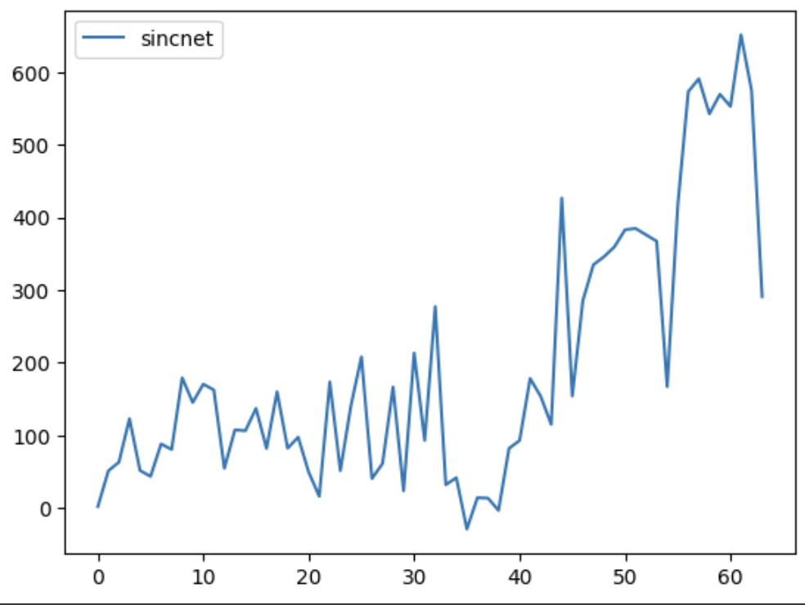
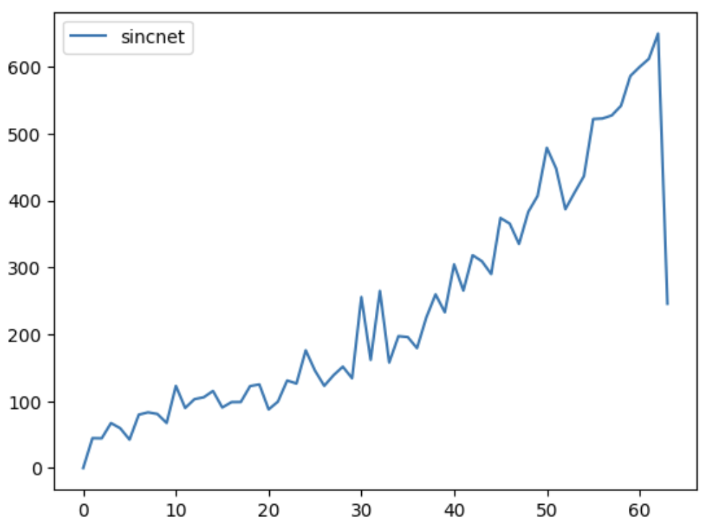
<CREMA-D>
<MSP-T>
Pitch
Pitch
Formants
Formants
Notes:
Interpretability can be before or after classification

Slide 11
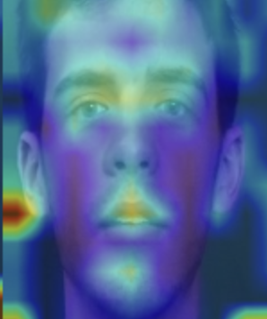
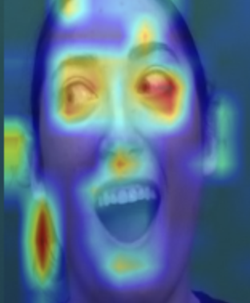
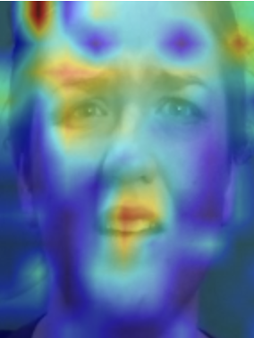
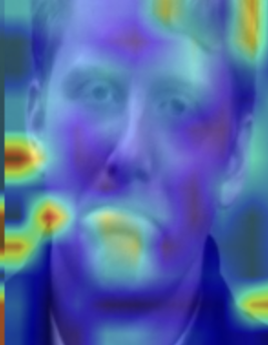
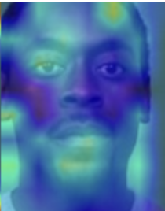
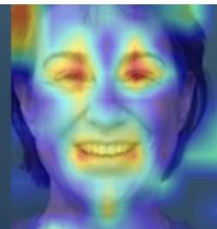
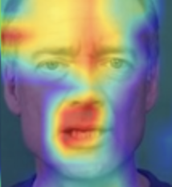
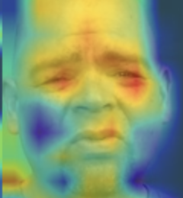
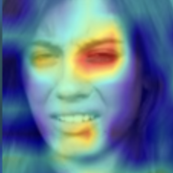
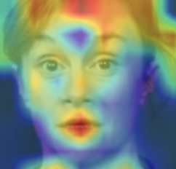
<MSP-T>
Neutral
Happy
Angry
Sad
<CREMA-D>
Neutral
Happy
Angry
Sad
Disgust
Fear
Notes:
Interpretability can be before or after classification

Slide 12
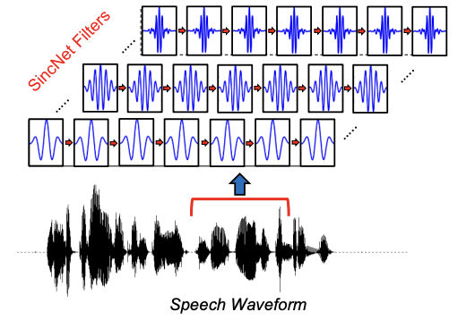
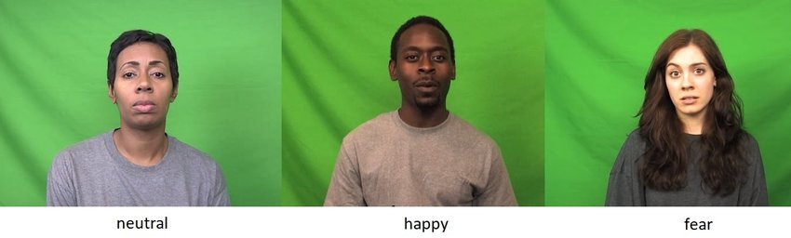
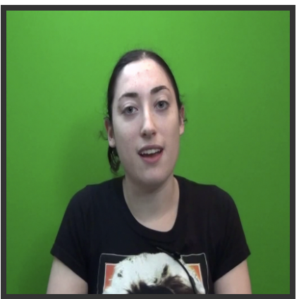
Bayesian NN
<Adding Explainability>
Cross modal interaction diagnose via EMAP
LeakyReLU
<Adding Interpretability>
SincNet Filter Analysis
<Adding Explainability>
Visual Explanation via GradCAM
Layer Norm
Deep Feature Extraction
Fusion
IF:
EMAP score is higher than threshold,
Take bimodal prediction
ELSE:
Take more confident unimodal prediction
Video
Notes:
Interpretability can be before or after classification

Slide 13

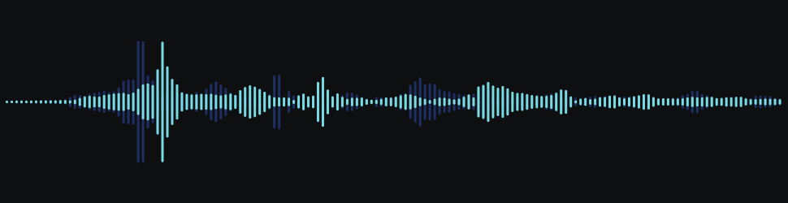
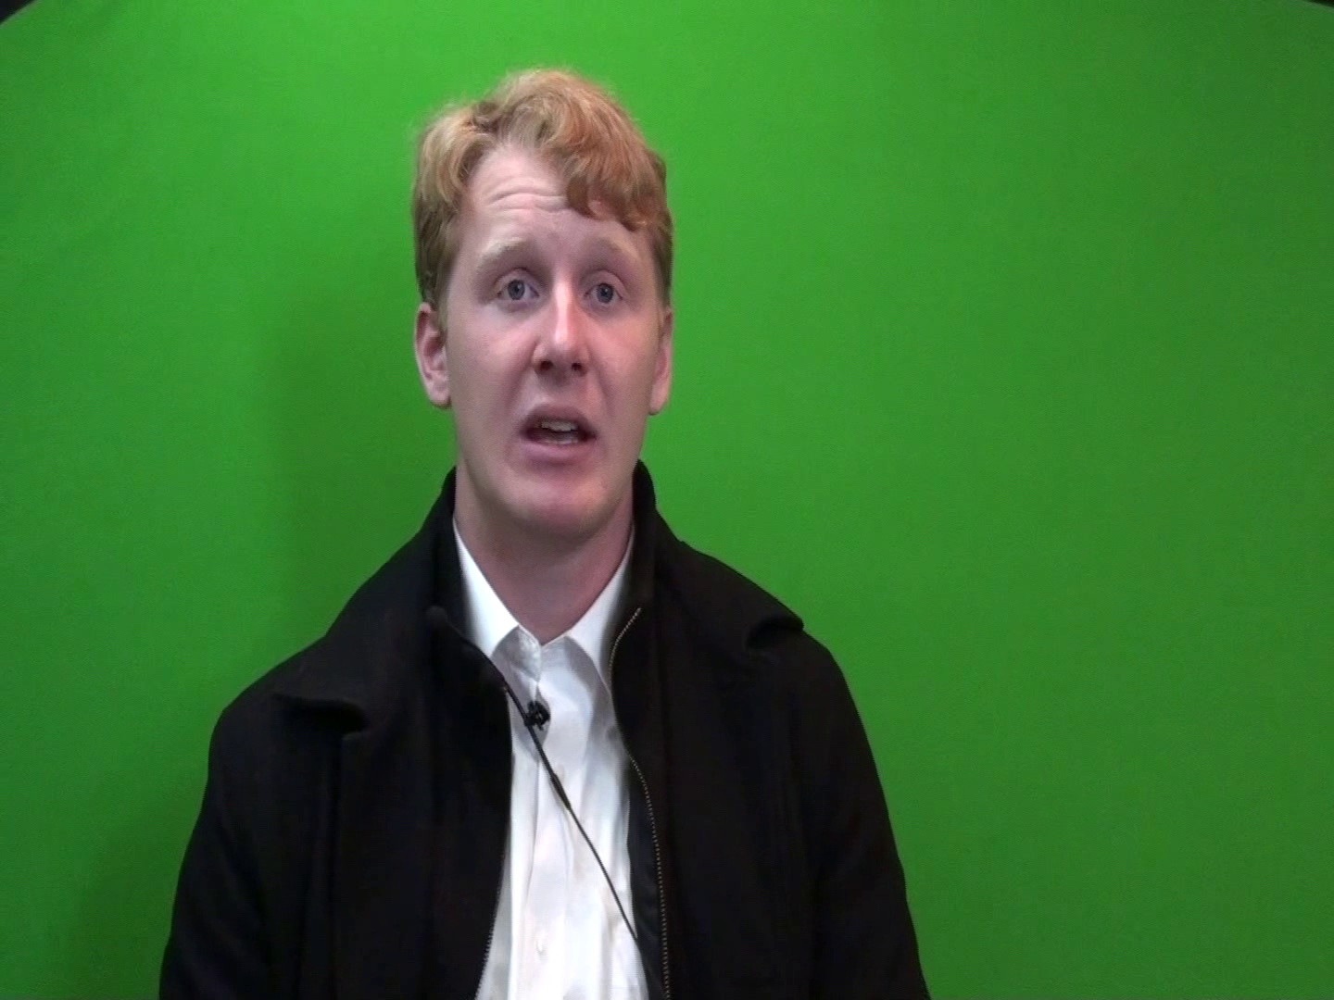
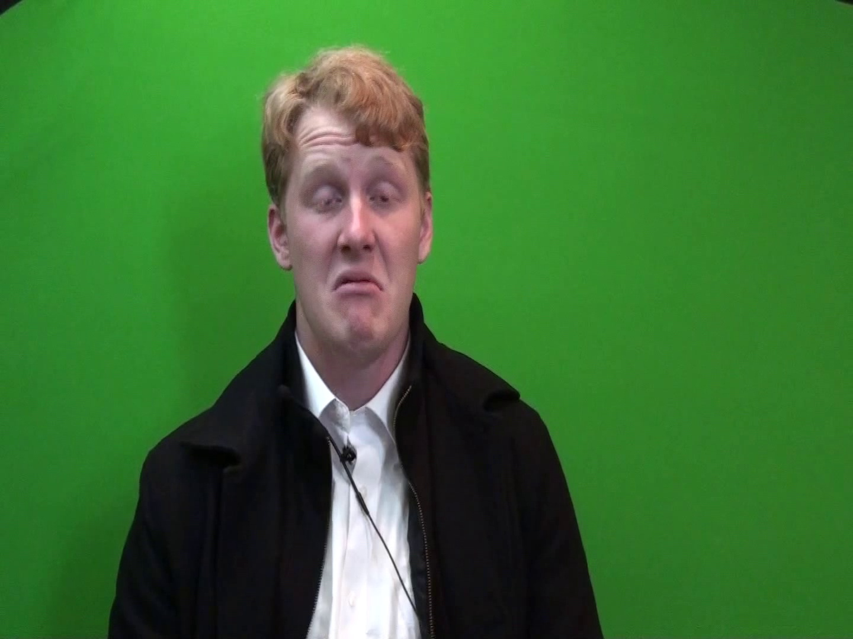

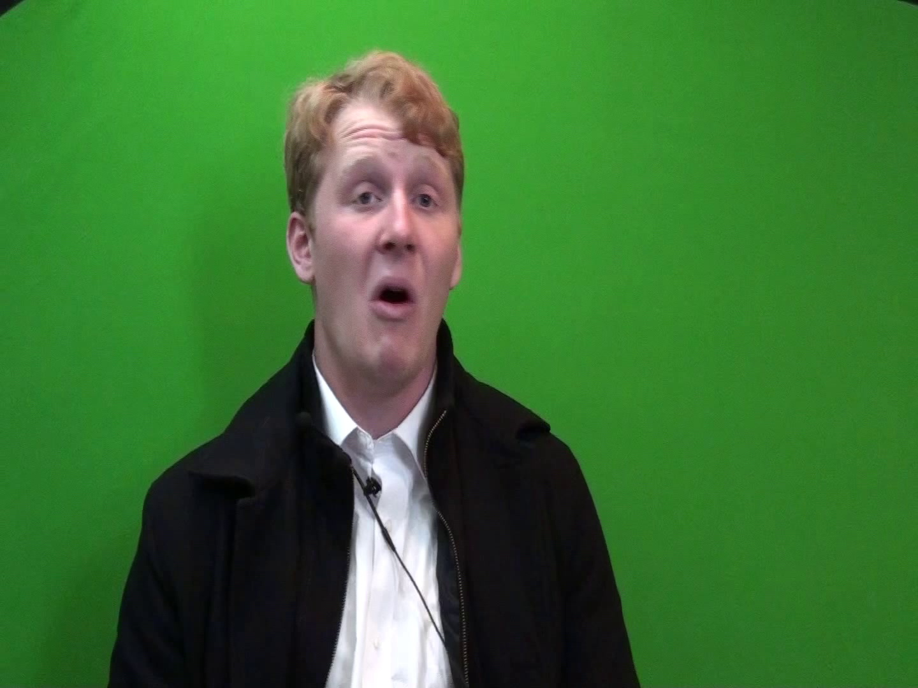
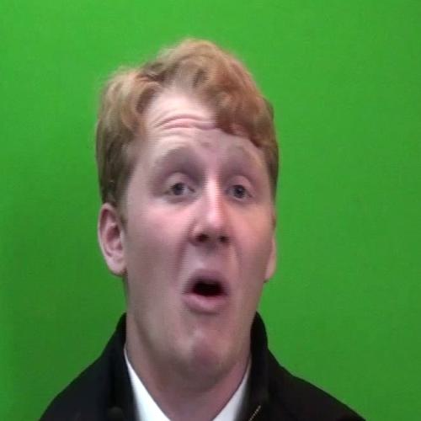
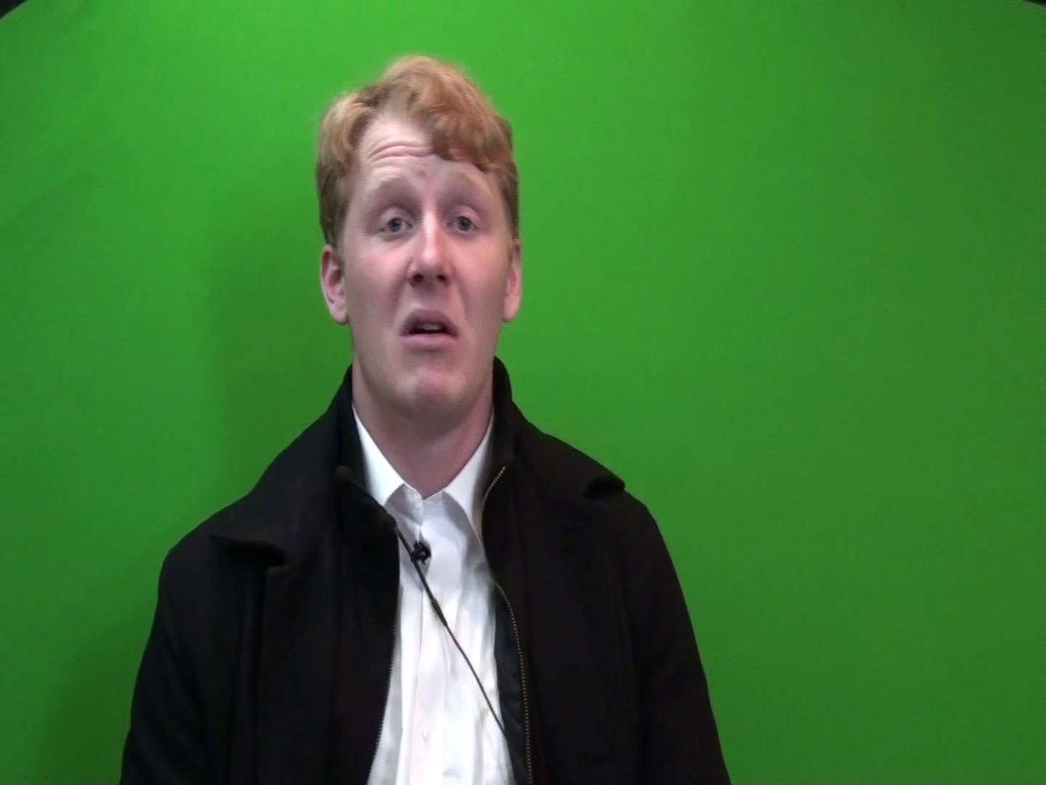
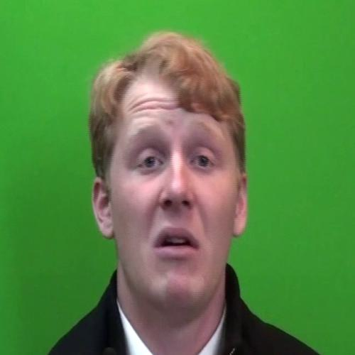

Method - preprocessing
<Audio>
<Crop Silence>
<Shared Fixed Length>
<Video>
<Image frames>
<Crop Faces>
Notes:
For Fusion method, we will use contextual bimodal attention fusion method
We will perform classification task using Bayesian Neural network to achieve interpretability by capturing uncertainty in our prediction

Slide 14
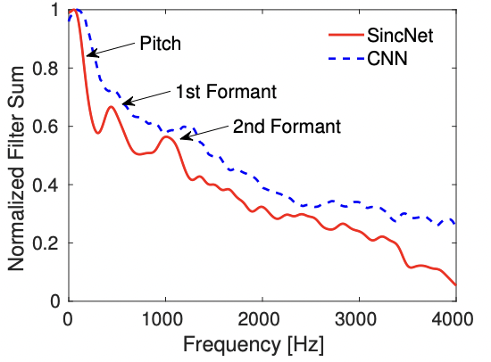
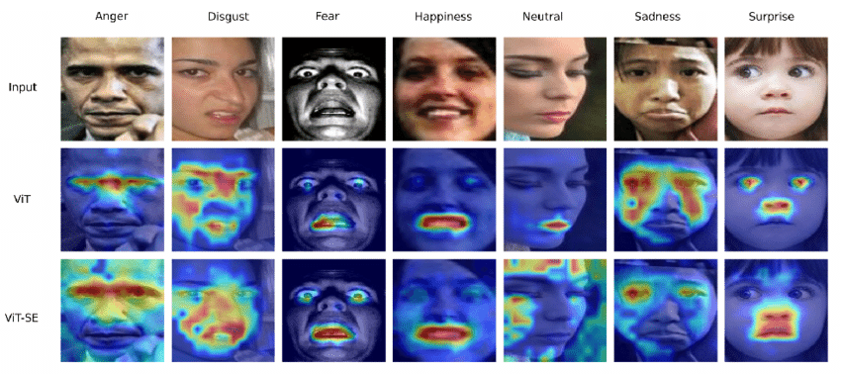
<Unimodal Classification>
<Adding Interpretability>
SincNet Filter Analysis
SincNet Filter + Convolutional Filters
Cross modal interaction diagnose via EMAP
<Bimodal Classification>
<Early/Late Fusion>
Deep Feature Extraction using ViT
<Unimodal Classification>
<Adding Explainability>
Visual Explanation via GradCAM
Video
Notes:
Interpretability can be before or after classification

